Slide 1
Topic: INBLF: Caring for Your Corporation in the COVID-19 Era Date: May 14, 2020 02:48 PM Eastern Time (US and Canada) Share recording with viewers:
https://us02web.zoom.us/rec/share/ztxfDrfZ205IH5GV5WvxQ6kIFYS9X6a8gScfq_UJxU1CU4FC3NJ9aXUcyP-1gLYf

Slide 2
CARING FOR YOUR CORPORATION IN THE COVID-19 ERA
(my evolving primer for topics to counsel clients on)
_________________________
BILL RICHTER, ESQ.
RICHTER LAW OFFICES
bill@richterlaw.com
https://www.linkedin.com/in/richterlaw/

Slide 3
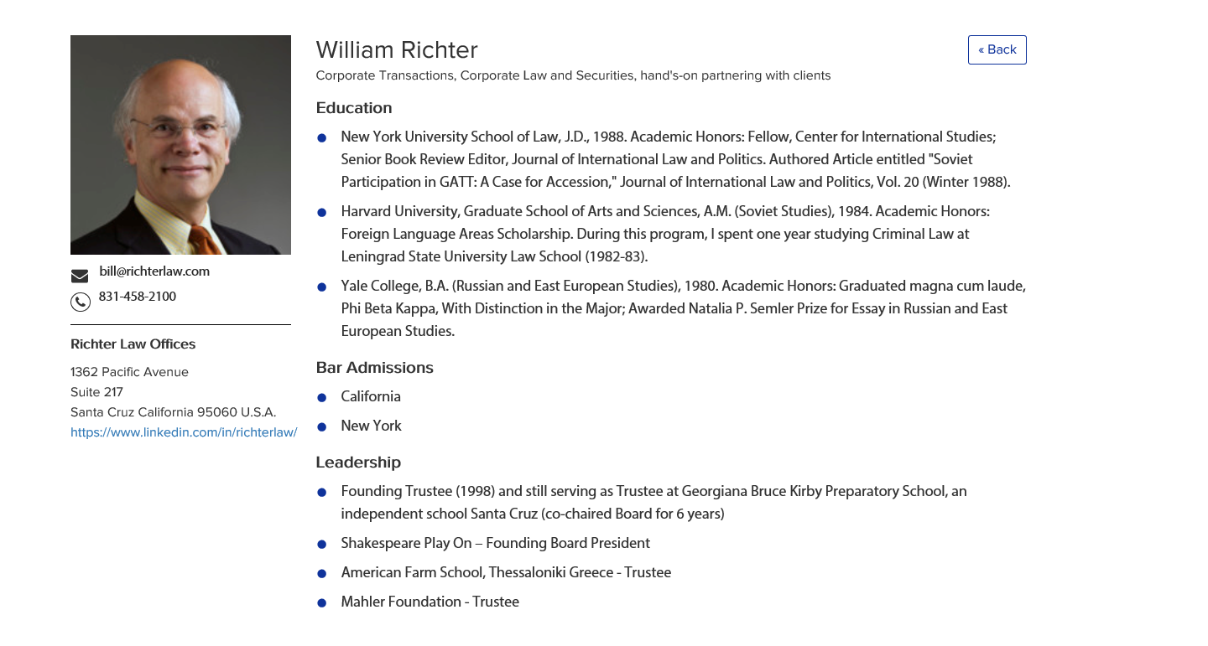
INBLF
Campaign Precision © 2020

Slide 4
Topic #1
Cautionary Words
Rule of Law, Still!
Other shoes will drop!
Campaign Precision © 2020

Slide 5
Topic #2
Ensuring Continuity of Ownership
How are shares held?
What’s in your shareholders’ agreement?
Campaign Precision © 2020

Slide 6
Topic #3
Fiduciary Duties in the C-19 Era
Duty of Oversight
Protecting Against Future Derivative Shareholder Suits
Campaign Precision © 2020

Slide 7
Topic #4
Ensuring Continuity of Governance
1. C-Suite Succession Planning
Adoption of “Emergency Bylaws” Under CA and DE
general corporation law
Campaign Precision © 2020

Slide 8
Topic #5
Thinking About Options Now:
Being Kind to Your Optionees
Extension of Post-term Exercise Period
Revisit Milestone vesting
New Grants
Repricing
Campaign Precision © 2020

Slide 9
Topic #6
PPP’s – a Panacea?
Experiences to date?
Dealing with uncertainty
Campaign Precision © 2020

Slide 10
Topic #7
Contracts, Contracts, Contracts
Commercial
Loan Agreements
Financing Documents and SAFES
Campaign Precision © 2020

Slide 11
Thank you
Campaign Precision © 2020

