Slide 1
Workplace Considerations in the Age of COVID-19
INBLF
August 13, 2020
This presentation is for educational purposes only as well as to provide general information and a general understanding of the law, not to provide specific legal advice. The statements and opinions expressed in this presentation are solely those of the presenter. Communicating with the presenter does not form an attorney-client relationship. This presentation should not be used as a substitute for competent legal advice from a licensed attorney in the appropriate jurisdiction.

Slide 2
Presented by
Ms. Hynes Mesco is an experienced business and employment law attorney who offers expert guidance to clients with employment and business-related needs. She frequently negotiates, drafts, and reviews employment, retention, non-compete, non-solicitation, equity, change-in-control, consulting, and other employment agreements and documents.
Ms. Hynes Mesco also advises employers regarding employment and business law-related issues, with a view toward litigation prevention and avoidance. She plays a leading role in The Prinz Law Firm’s workplace training offerings. She has provided custom-tailored trainings to numerous employers, helping them update their policies, develop best practices, and create positive workplace cultures that allow businesses to thrive and employees to feel appreciated.
Christina Hynes Mesco
Of Counsel, The Prinz Law Firm, P.C.
cmesco@prinz-lawfirm.com

Slide 3
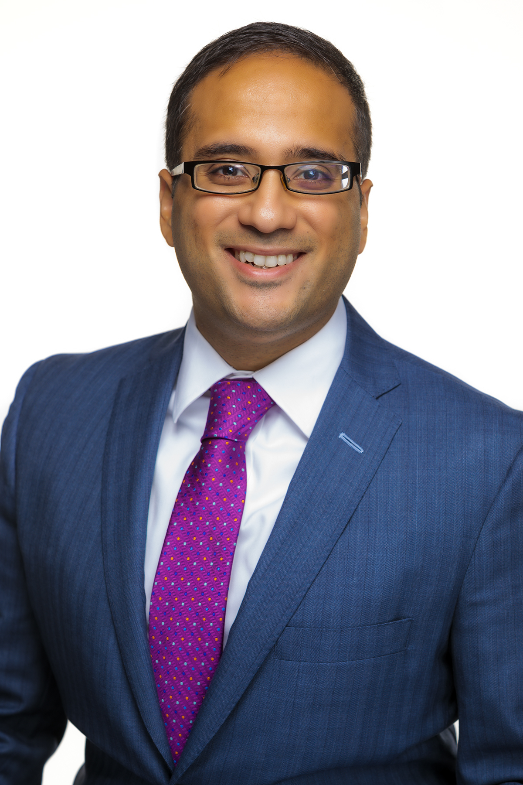
Presented by Amit Bindra
Experience in all aspects of employment law, including physician employment agreements, non-compete and trade secret lawsuits and agreements, executive and equity agreements, wage and hour issues, employee handbooks, and employment discrimination.
Works with business owners, executives, and physicians on matters in Illinois and across the U.S.
Publications in law journals, legal newsletters, and The Prinz Law Firm’s blog.
Teaches legal education courses to other attorneys, teaches a legal writing and advocacy course at a law school, and appears on podcasts.
Since 2016, recognized as an Illinois Rising Star by Super Lawyers Magazine.
Amit Bindra
Partner, The Prinz Law Firm, P.C.
Adjunct Professor,
Loyola University Chicago School of Law
abindra@prinz-lawfirm.com
312-212-4450

Slide 4
COVID-19 and
Returning to Work

Slide 5
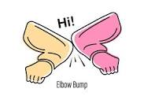
On-Boarding during a Pandemic
Plan an Initial (and possibly ongoing) in-person meeting
Consider outdoors if possible to be mindful of health concerns, but meeting in the office can also help the employee feel a greater sense of belonging
Assign a Peer Mentor – Hire in Cohorts
Assign a high-performing peer to help be a resource
Intentionality is Key
Schedule regular video meetings and calls
Implement a formal probationary plan so feedback is provided at regular intervals

Slide 6
Return to Office Considerations
Create Safety Protocols
Implement daily wellness checks, employee face masks
Install wipeable workstation dividers and guards; have readily available sanitizers for employees and guests
Consider office alterations, including air purifiers, removal of common touchpoints
Set social distancing standards for your office, including limiting number of employees/clients at locations within your office
Create a COVID-19 Response Plan
If someone reports an infection, isolate, contact trace, investigate, disinfect, notify, and provide paid leave if eligible
Social Distance Huddle

Slide 7
Title VII

Slide 8
Employment Discrimination
Federal, state, and local laws prohibit discrimination and retaliation based on protected characteristics (including gender, race, national origin, religion, age over the of 40, disability, or genetic information.
Use business reasons for requiring employees to return to the office.
Multiple areas of potential harassment in light of last 6-months.
National origin and race discrimination (Asian-American employees, employees of Asian descent, and Black employees).
Targeted harassment towards employees returning from sick leave.

Slide 9
Employment Discrimination (continued)
Action steps:
Reiterate anti-discrimination and anti-retaliation policies to all employees (even if employees are working remotely).
Reiterate reporting policies.
Separately, communicate policies to management employees.

Slide 10
Employment Discrimination (continued)
Older workers and accommodations.
The older worker protections prohibit discriminating against older employees.
But the laws does not require an interactive process or accommodations.
Employees can provide flexibility to workers 65 and older.
Pregnancy protections.

Slide 11
ADA
There is an obligation to engage in the interactive process to determine if there is a reasonable accommodation.
Low cost solutions.
Protective gear.
Medical documentation can still be requested.
An accommodation does not need to be provided if it poses an “undue hardship.”
Employee confidentiality.

Slide 12
Additional legal concerns

Slide 13
COVID-19 and Privacy
Employee Medical Privacy
Temperature and wellness checks are “medical examinations” under ADA
Tests should be conducted in a location that allows for employee privacy
Consider whether to record the results and if so, maintain confidential records properly (separately for seven years)
Monitoring Employees Working from Home and Employee Privacy
Be cognizant of what data is collected, how it is used, and employee legal protections
Security of Confidential Business Information
Ensure employees understand data security protocols – how to safely access and store sensitive data from home

Slide 14
Wage & Hour Issues
Fair Labor Standards Act Considerations
Employee Expense Reimbursement
In the absence of a written policy setting limits regarding reimbursement, employers are liable for all necessary expenditures or losses incurred by the employee within the employee's scope of employment and directly related to services performed for the employer.
Families First Coronavirus Response Act (FFCRA)
Amended the Family and Medical Leave Act (FMLA), known as the Emergency Family and Medical Leave Expansion Act (EFMLEA), and created federal paid sick leave - the Emergency Paid Sick Leave Act (EPSLA).
Who is a Covered Employer?
Who are Eligible Employees?

Slide 15
Other updates

Slide 16
Supreme Court and Employment Law
Bostock v. Clayton County, No. 17-1618, 590 U.S. (decided June 15, 2020).
In a 6-3 decision, Justice Gorscuh wrote the majority opinion that an individual’s sexual orientation is covered under the “gender” prong of Title VII.
Thus, the Court held that Title VII prohibits discrimination because of an individual’s sexual orientation or gender identity.
Our Lady of Guadalupe School v. Morrissey Berru, No. 19-267, 591 U.S. (decided July 8, 2020).
In a 7-2 decision, Justice Alito wrote the majority opinion in which the Court extended the ministerial exception to employees who do not have the title or training of a religious leader.

Slide 17
Legislative Updates
Congress is still debating the HEALS Act and the Heroes Act.
Disagreements over the extension of the enhanced unemployment benefits.
Both would extend the paycheck protection program.
The HEALS Act includes a return-to-work bonus and liability protection for COVID-19 illnesses.
The Executive Order.
Extension of unemployment benefits.
Payroll tax deferral.

Slide 18
Questions?

Slide 19
Thank you!
This presentation is for educational purposes only as well as to provide general information and a general understanding of the law, not to provide specific legal advice. The statements and opinions expressed in this presentation are solely those of the presenter. Communicating with the presenter does not form an attorney-client relationship. This presentation should not be used as a substitute for competent legal advice from a licensed attorney in the appropriate jurisdiction.

